Slide 1
MEASURING COMPLEXITY
With Maxim Danilov

Slide 2

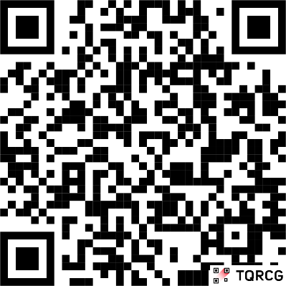
Who I am:
Maxim Danilov
Work with Python and Django
Love reactive frontend frameworks.
Mentor in engineering
Repo:
github.com/danilovmy/pyconpl2025

Slide 3
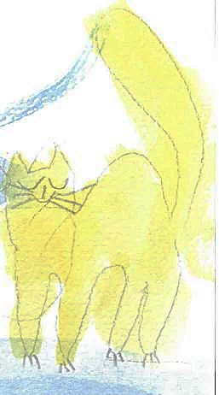



Special thanks to my family for the support:
cat
Kisa
daughter Maja
son
Mark
dog
Marselle
My wife
Elena

Slide 4
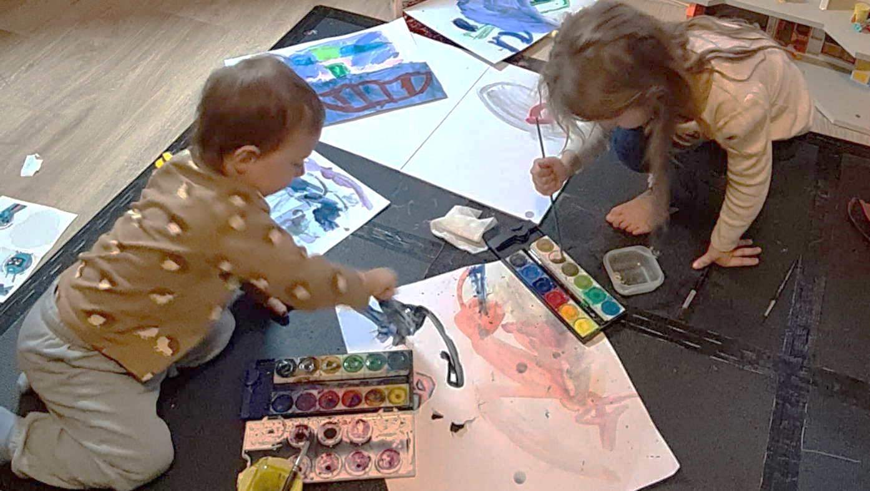
Thanks to my children Mark & Maja for the illustrations

Slide 5

Complexity
Theoretical part

Slide 6
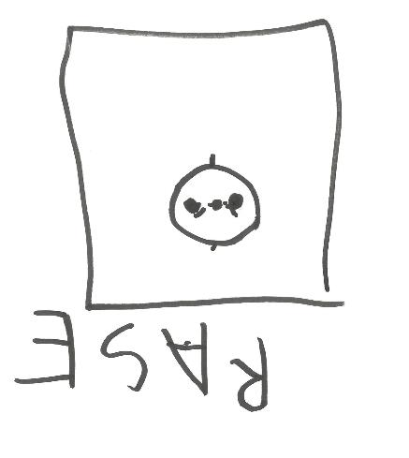

What is Complexity
This is a set of metrics that represents:
how difficult it is to
understand,
modify,
and use
software correctly

Slide 7

Different shadows of Complexity:
Structural
Grows with relations between objects
Cognitive
Appears by developers
Accidental
Happens in development
Essential complexity
(technical)
Present in algorithms.

Slide 8
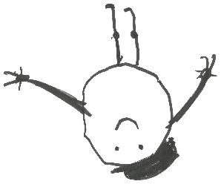
Complexity in project
Business
tasks
Development
Knowledge

Slide 9
Peaks of complexity
Business
tasks
Development
Knowledge

Slide 10

Vortex of doom
Complex
Business
tasks
frequency
of changes
Critical mass of tech debt
bug fixing
making new bugs
while fixing old ones
go back to step 1
SC
Missing knowledge
Vortex of doom
CC
AC

Slide 11
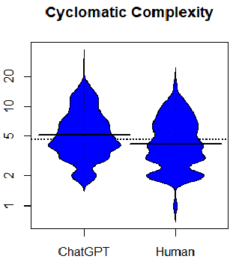

Complexity in the Age of AI
AI itself amplifies complexity
AI increases code churn and technical debt
Humans still maintain AI-generated code,
and debugging it becomes harder

Slide 12
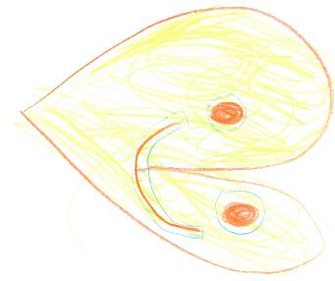
Measuring Complexity – code health check
AI speeds up coding but doesn’t track complexity
Without monitoring the complexity grows silently, and much more extensive with AI-generation.
Metrics let us supervise AI-generated code
Regular complexity checks can help predict the appearance of complexity peaks or the “Vortex of Doom.”

Slide 13

Measuring complexity
Practical Metrics

Slide 14
Raw metrics
LOC – The total number of lines, weight of project
SLOC - The total number of lines with code, this code we read
LLOC - The number of logical codelines. This code we run
Smaller values indicate lower complexity

Slide 15
raw_metrix example
DJANGO
FastAPI
total files 883
LOC 157.978
SLOC 125.889
LLOC 9.0981
Average 178lines/file
total files 42
LOC 17.763
SLOC 15.541
LLOC 3.637
Average 423lines/file

Slide 16
Additional raw metrics
The number of comments.
Used as comments-coverage ( comments / SLOC )%
The number of blank lines.
The number of Docstrings / Multiline-strings.

Slide 17
How to measure:
Talk repo:
python raw_metrics.py <folder>
Sonarcloud, wily, codeclimate… - all tools built on Radon count SLOC/LLOC wrong!!!

Slide 18
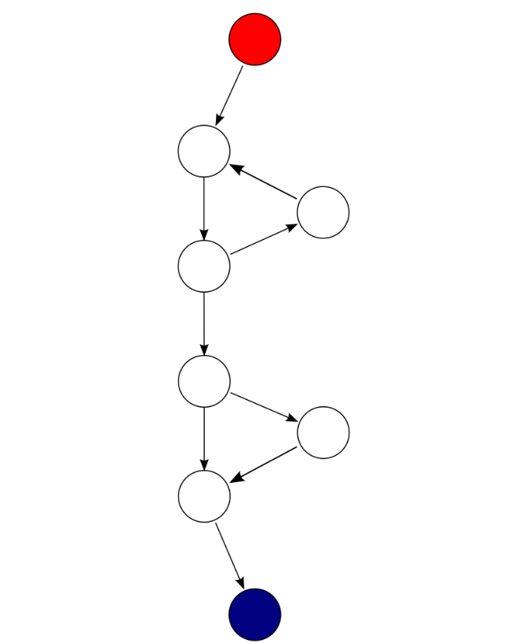
Cyclomatic Complexity (McCabe)
Shows the number of decisions made in source code
Get a sense of how hard given code might be to test
Lower index is better

Slide 19
McCabe index example
DJANGO
FastAPI
total files 883
django\...\related_descriptors.py
'create_forward_many_to_many_manager’
is too complex (71)
django\...\template.py
'templatize’ is too complex (51)
total files 42
fastapi\_compat.py
'If 46' is too complex (68)
fastapi\encoders.py
'jsonable_encoder' is too complex (29)

Slide 20
McCabe pro/cons
✅ Pros
⚠️ Doubts
Clear, how to compute
Shows minimum number of test cases
Hotspot Detection
Does not reflect readability
Not reflect naming clarity
Formula unchanged since 1976, never recalibrated

Slide 21

How to measure:
flake8 --select C901 <folder>

Slide 22
Halstead complexity metrics
Reflected the difficulty of the program to write or understand
Based on work with statements, operators and words in code:
n1 = Quantity of used unique words like names in code
n2 = Quantity of used unique operators between words in code
N1 = total Quantity of used words in code
N2 = total Quantity of used operators in code

Slide 23
Halstead metrics example
DJANGO
FastAPI
django\...\related_descriptors.py
'vocabulary': 380,
'...
'difficulty': 141.22478386167148,
...
bugs 14.640169997565371
…
fastapi\_compat.py
'vocabulary': 271,
…
'difficulty': 67.33469387755102,
…
bugs 5.541660192688304
…

Slide 24
Halstead Metrics results
Program length and vocabulary
Volume of code dictionary
Difficulty to understand codebase
Effort to maintain code
Time required to maintain code
Number of delivered bugs

Slide 25
Halstead pro/cons
✅ Pros
⚠️ Doubts
Shows density of words on code
shows Difficulty for understanding
Not bound to a specific language
Clear, how to calculate
Formula unchanged since 1977, never recalibrated.
Not reflect structural complexity
Not very useful for very large projects
Parsing problems with newer versions of Python

Slide 26
How to measure:
Talk repo:
python halstead.py <folder>
Wily, codeclimate, Codacy… - all tools built on Radon count n1, N1 (operators list) not correct!!!

Slide 27
Maintainability Index
Created by Software Engineering Institute in 1997
171 - 5.2*ln(Hal) - 0.2*Cycl - 16*ln(SLOC) + 50*sin(sqrt(2*Comments))
Index value | Color | Meaning
0-9 | Red | Low maintainability of code
10-19 | Yellow | Moderate maintainability of code
20-100 | Green | Good maintainability of code

Slide 28
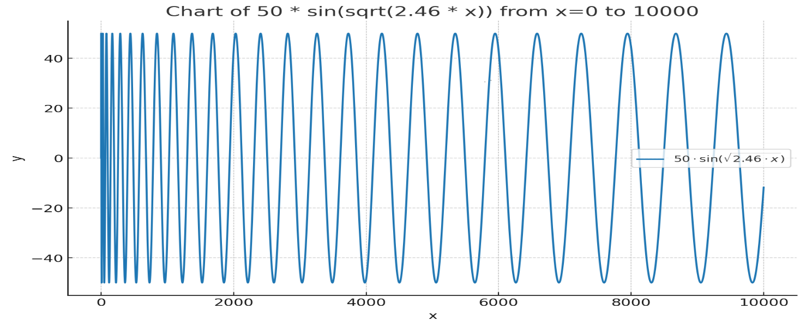
Example Calculation

Slide 29
Other problems of MI
Originally created for Pascal and C in the early 1990s
For check used projects from Hewlett-Packard
Magic numbers
Implemented by Radon, SonarQube, Microsoft Visual Studio, Wily, ProjectCodeMeter…

Slide 30
How to measure:
Don’t measure Maintainability Index.
Or any tool for your taste.

Slide 31
Coverage metrics
Shows – how much time is invested in activity to support development
Code coverage – count of executed lines in code.
Docstring coverage - count or documented objects in code.

Slide 32
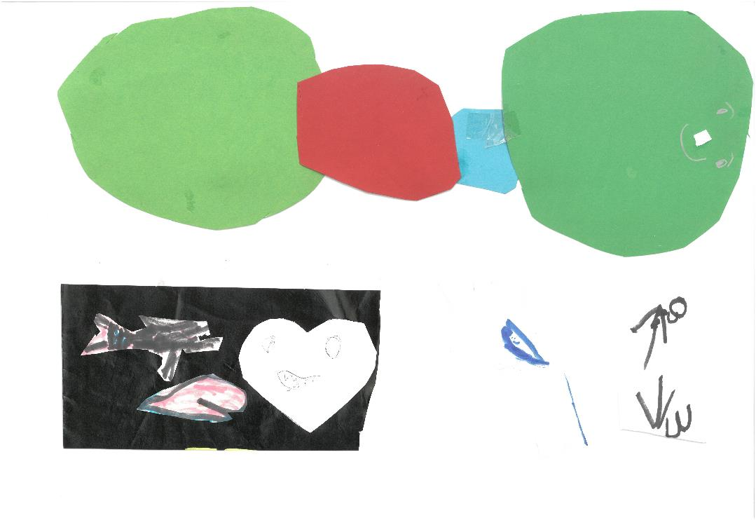
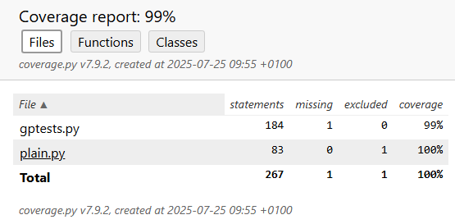
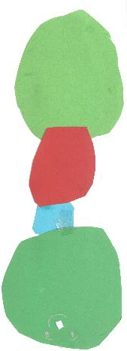
Code Coverage example

Slide 33
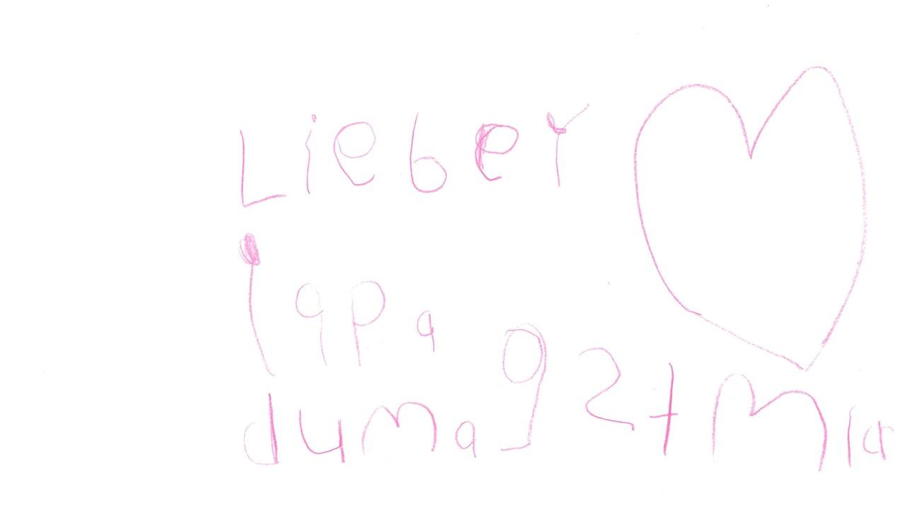
How to measure
coverage run -m unittest discover

Slide 34

Documentation Coverage example
Needed: 4; Found: 0; Missing: 4; Coverage: 0.0%
Overall statistics for 153 files (15 files are empty):
Needed: 779 - Found: 3 - Missing: 776
Total coverage: 0.4%
- Grade: Do you even docstring?

Slide 35

How to measure
docstr-coverage <project_folder>

Slide 36
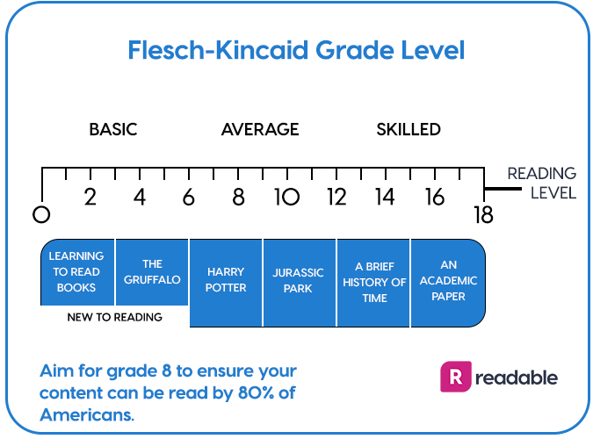
Text readability metrics
Shows
easiness
for reading
FastAPI

Slide 37

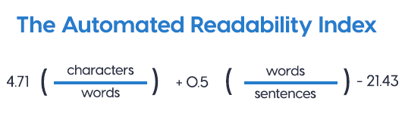
Text readability suggestions
Measuring only for docstrings and comments
The best is Automated Readability Index.
It shows the U.S. grade level required to read a text.

Slide 38

How to measure
Talk repo:
python readability.py <folder>
Or any tool like py-readability-metrics

Slide 39

Additional Complexity Indexes
Cognitive Complexity:
Sonar Cloud
Tech Debt metrics:
CodeClimate
Composite code quality index:
Codacy

Slide 40

CI/CD/Continuous Measurement
Dont forget to measure .

Slide 41

Complexity preemptive actions
git pre commit hook - alerts when limits exceeded
AI-agents don’t check maintainability. We should feed complexity metrics into feedback loops (like RLHF for code quality) and teach agents to prefer simpler, more robust code.
AI Auto-tuning prompts like:
“reject code that exceeds cyclomatic 10”
“prefer low-entropy, well-structured functions.”
“WRITE BETTER CODE”

Slide 42
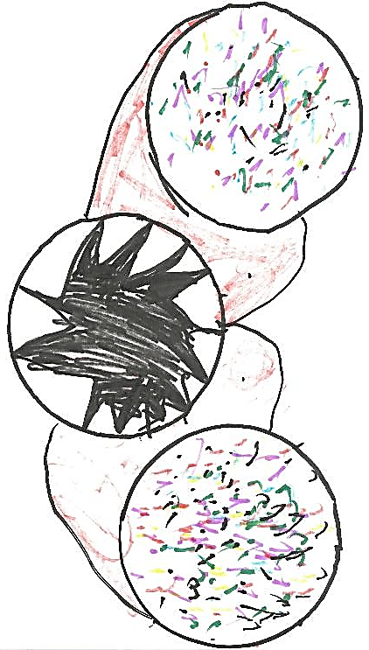
Final Recap
Metrics are indicators, not goals.
Any complexity metrics is subjective
Avoid blind reliance on MI
Track trends, not just snapshots
Metrics are not absolute truth. Use intuition.

Slide 43

Try It at Home
Install module_extractor/radon/ SonarCloud
Get raw metrics for your own project.
Add metrics into CI/CD and in Setup prompts for AI-agent
Enjoy

Slide 44
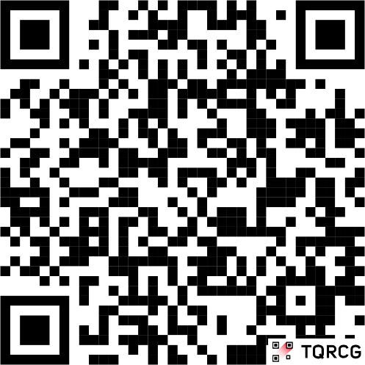
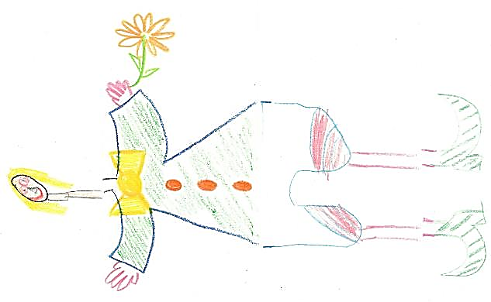
Thank you for attention!
Maxim Danilov
maxim@wpshop.at
Repo: github.com/danilovmy/pyconpl2025

Slide 45
Useful links
https://www.researchgate.net/publication/391792650_AI_vs_Human_Programmers_Complexity_and_Performance_in_Code_Generation
https://simonwillison.net/2025/Jan/3/asking-them-to-write-better-code/

